Slide 1
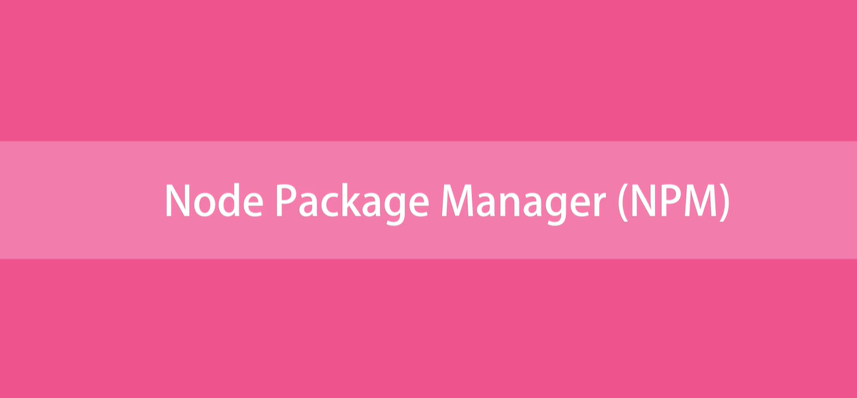

Slide 2
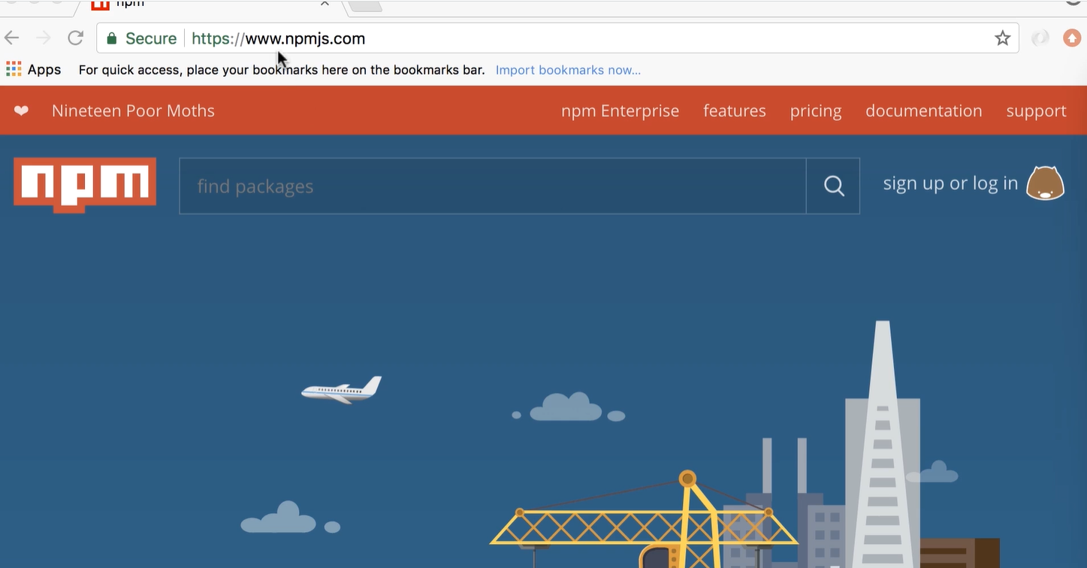
What its NPM
Command line tool
A registry of third-party libraries for Node application.
Any kind of functionality you want to add to your application there is most likely a free, open sourced library or package.

Slide 3
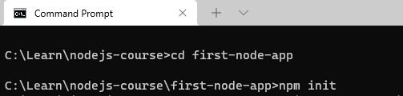
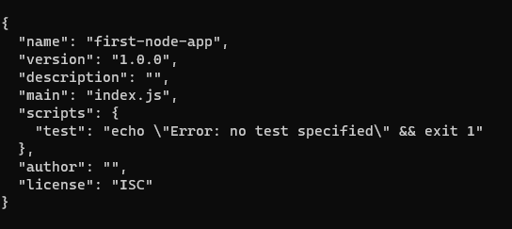

Package.json
We got packge.json file with all those default values.
The package. json file is the heart of any Node project. It records important metadata about a project which is required

Slide 4
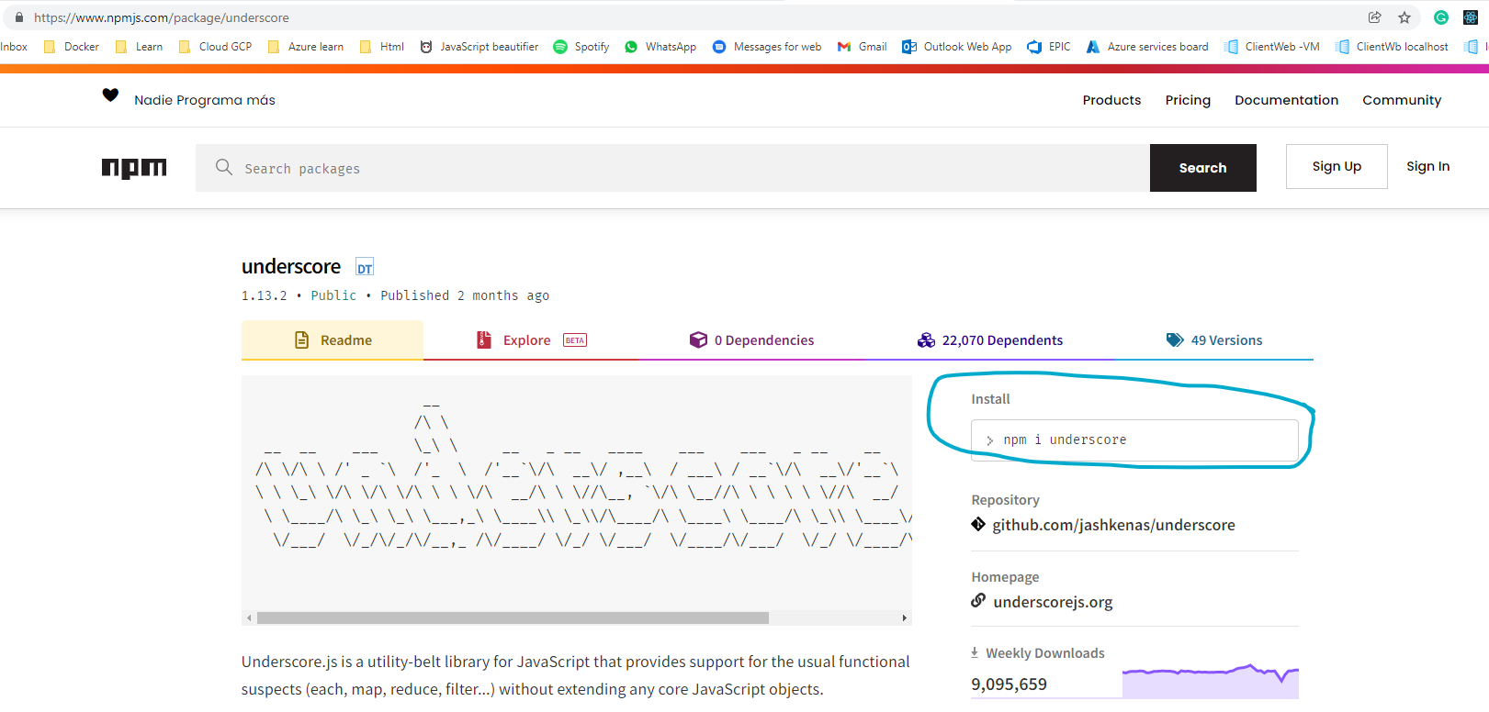
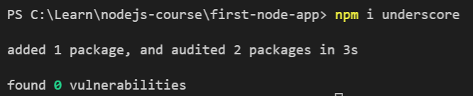
Installing a Package
How to add third party library into your project.
There is popular JS library called underscore. (npm install underscore)

Slide 5
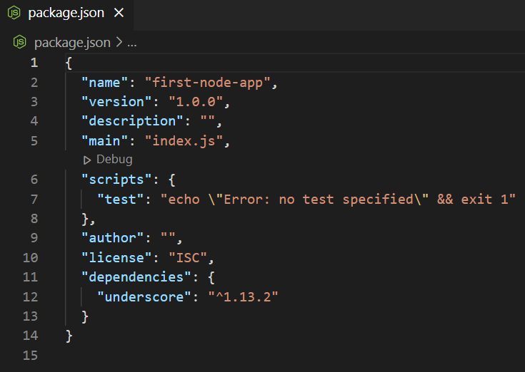
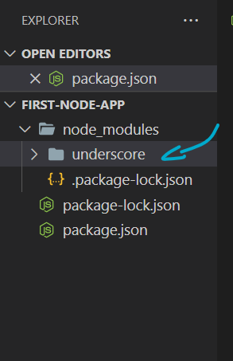
Installing a Package
When u run the install command the package will be added to packge.json
Npm will download the latest version of that package.
Also the laibery will be stored under node_modules folder.

Slide 6
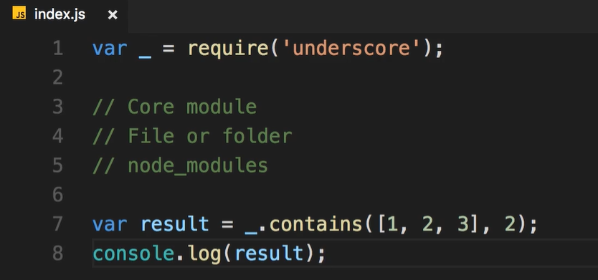
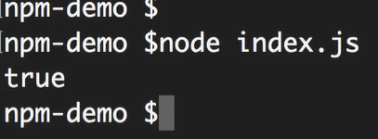
Using a Package
When we use a package, NodeJS first assume that this module is a core. In node (core)
we don’t have module called underscore. So, the require function think maybe this underscore is a File or Folder in this project.
So, the NodeJS assumes that this module we have specified here exists inside node_modules folder.

Slide 7
Packages dependencies
Exercise install a package called mongoose

Slide 8
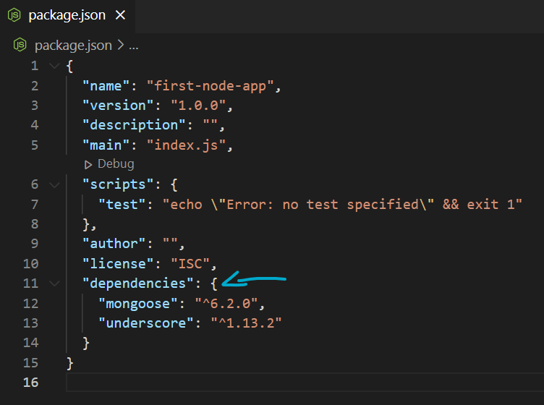
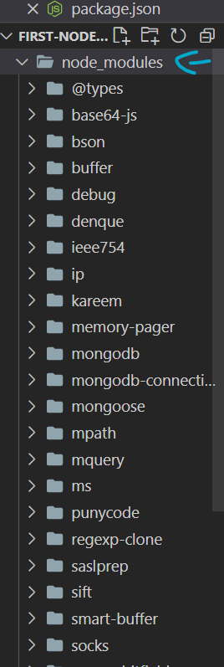
Packages dependencies
From where all this file come from? We didn’t install any of these libraries, we only installed Mongoose And underscore ?. This libraries Mongoose is dependent upon. What happens when we have packages that use diffrent libraries versions ?

Slide 9
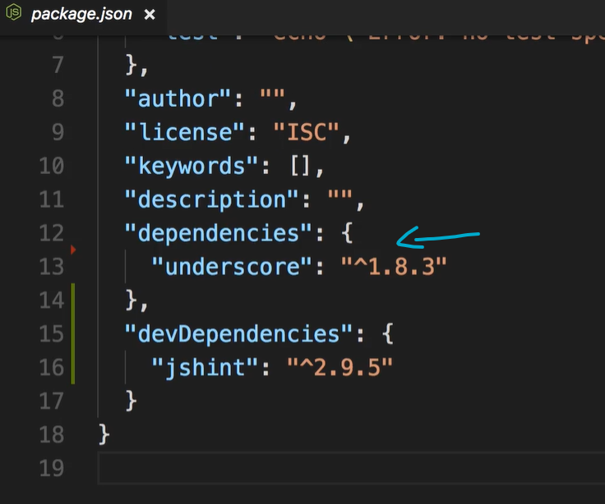
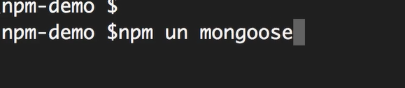
Uninstalling a Package
Also removed from the node_module folder

Slide 10
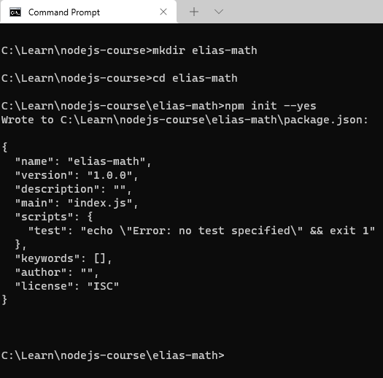
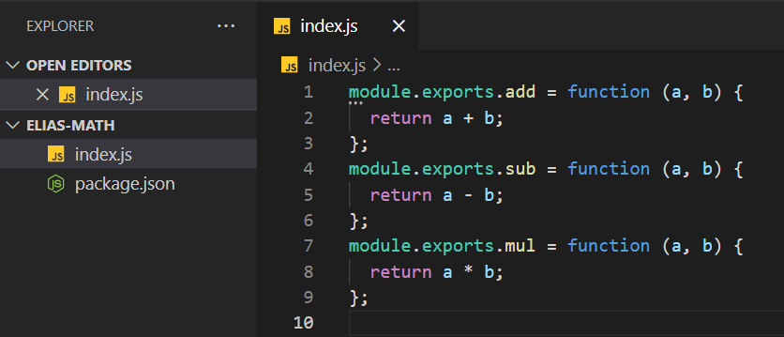
Publishing a Package
We create index.js file because its our entry point
for that package that we are creating.

Slide 11
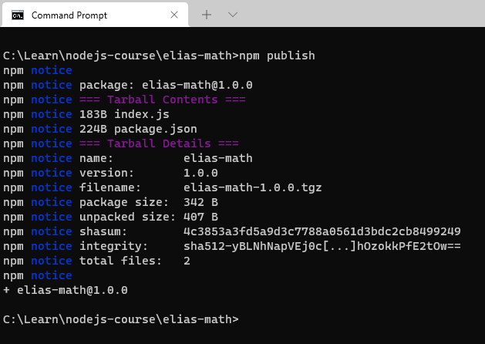
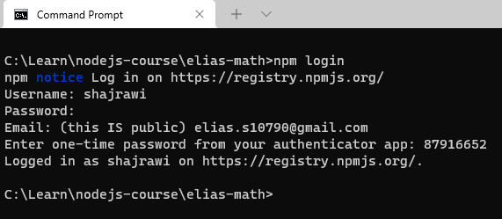
Publishing Package
Login to your account. Create one in npmjs.com if u don’t have a one
Publish your package. And u can use it anywhere u want
You can find your package in npmjs.com

Slide 12
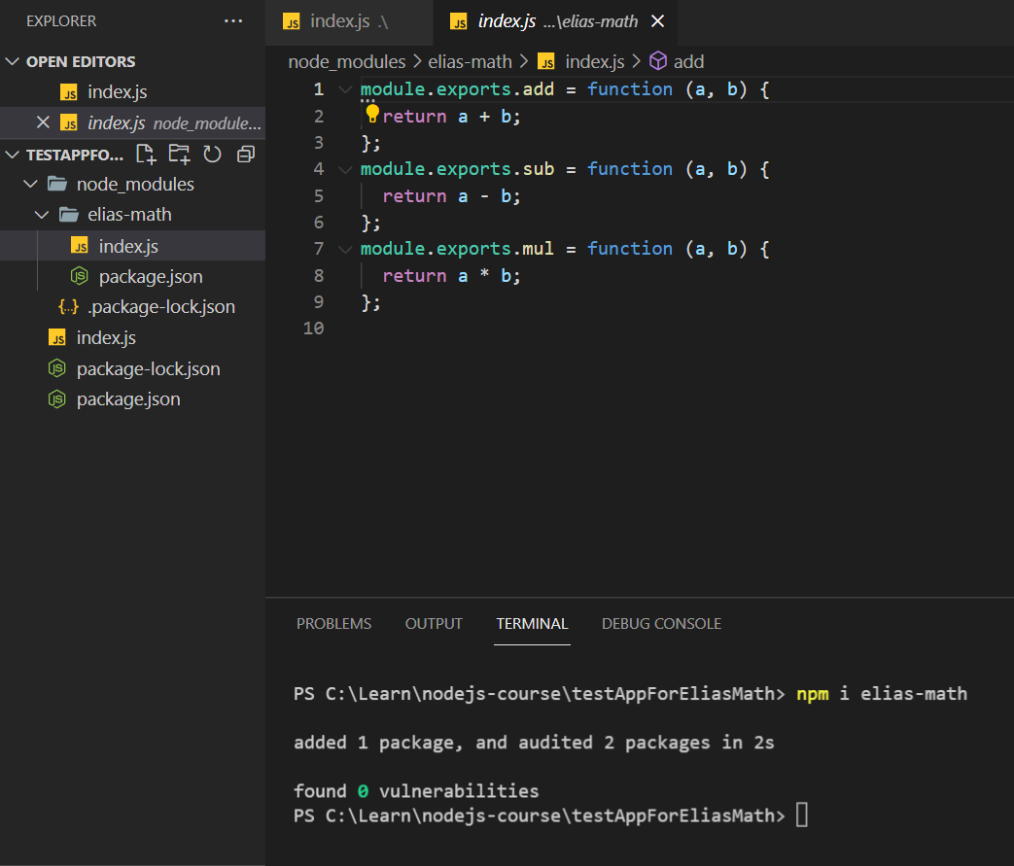
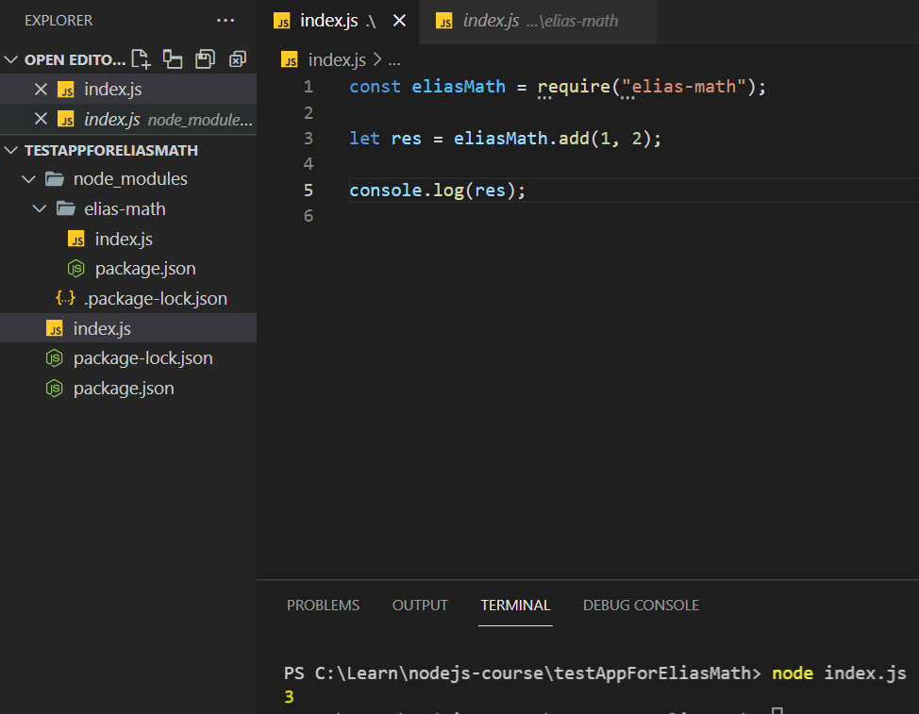
Using package that already published

